Slide 1
Test SET optimization
Amir Avitan Stav Sapir

Slide 2
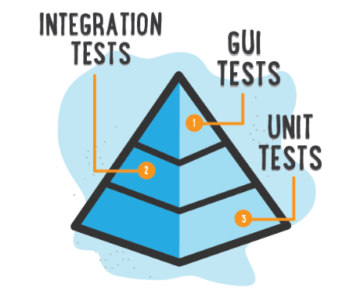


Motivation
Lots of code…
Need to test…
Many tests…Which should I choose?

Slide 3
Input
Software components (classes) with probability for having bug(failure).
Single test pass trough subset from n software components (classes).
Each test has its joint probability for having bug(failure).
Each test has its joint probability for pass(success).
Real outcome of tests trace(0 –fail 1- pass).

Slide 4
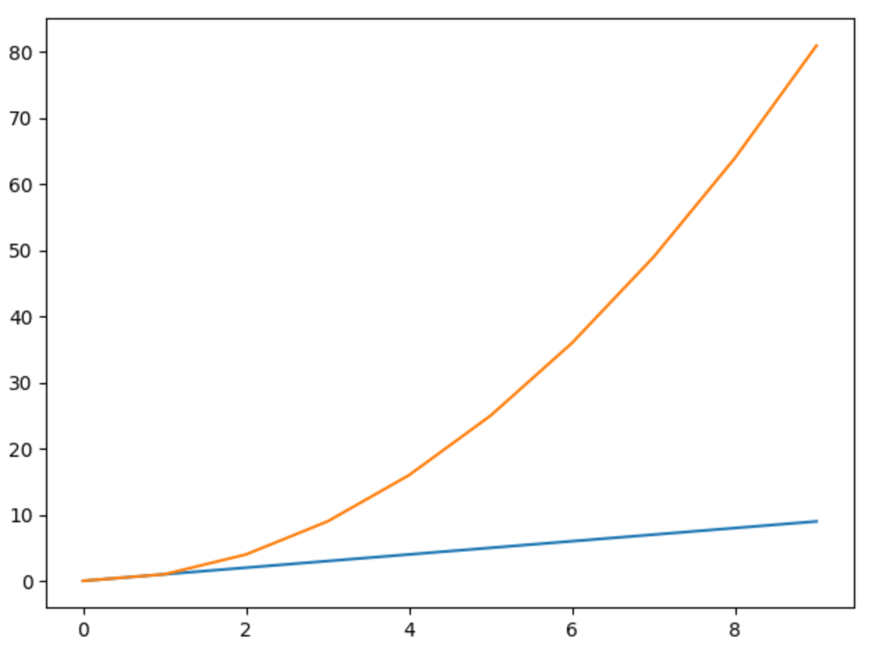

Target OUTPUT
Sub -Set of tests of constant size that maximizes the number of bugs.
# of Bugs
Tests #

Slide 5
Algorithm
Calculate components failure entropy for all components.
For predefined number of tests do:
Calculate test entropy (components failure entropy) by simulate running test with fail and pass outcome.
Calculate test components new failure probabilities using SFL Diagnoser.
Choose the test with minimum entropy = maximum information gain given the previous tests already chosen.
Continue choose tests till reach n (predefined number of tests ).

Slide 6
Test Entropy Definition
Test Entropy = TestE1 + TestE2
Where :
TestE1 = success_probability(test) * success_entropy(test)
TestE2 = failure_probability(test) * failure_entropy(test)

Slide 7
Project Status
Done:
Data load into suitable data structures
Test entropy calculations implementation
Generate planning file for SFL diagnoser
Integrate SFL diagnoser and get updated priors
To be Done:
Verify correctness & test main iteration
Calculate chosen test failures metric.
Compare chosen tests execution outcomes Vs. Top n tests with failure highest probability

Slide 8
Thanks!

